Slide 1
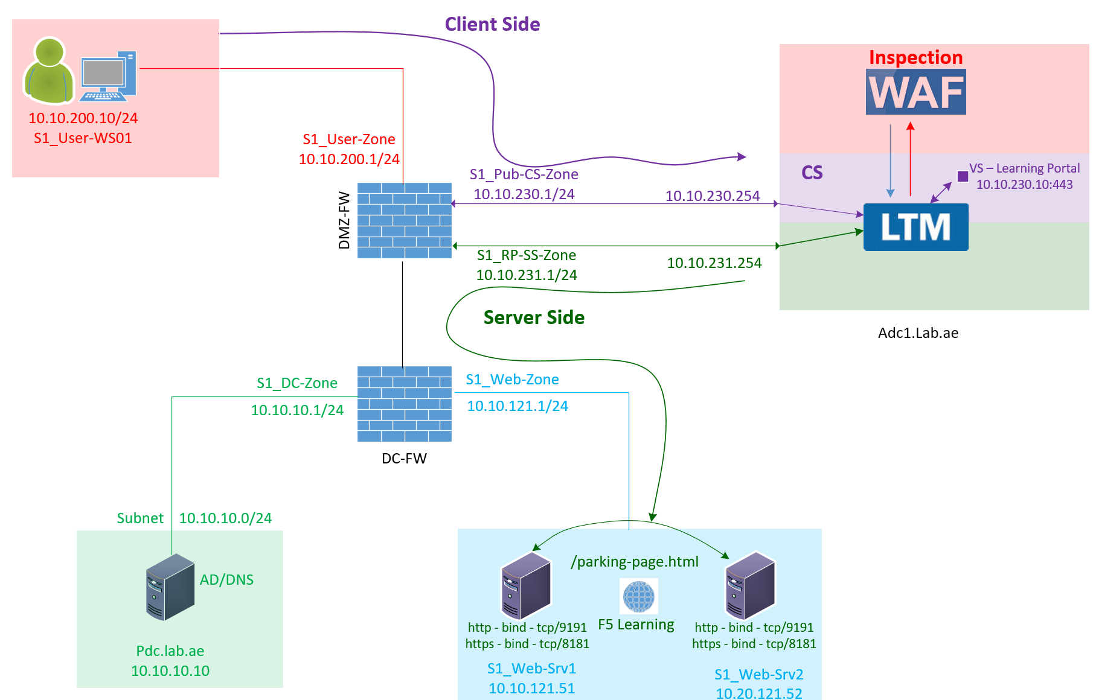

F5 LTM Learning with
Alexander S
Chapter 04 – F5 LTM operates as a Full Reverse Proxy

Slide 2
This video is a continuation of Chapter 03.
Before you continue, I highly recommend watching Chapter 03 first, where we discuss why a reverse proxy is needed, especially from a load-balancing and security perspective.

Slide 3
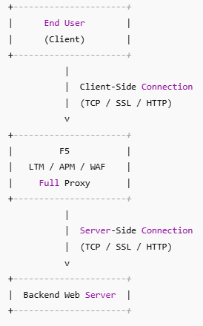
    Reverse Proxy – F5 LTM works as a full reverse proxy
F5 works as a full reverse proxy
What does “full proxy” mean?
  In a full proxy architecture, the client-side and server-side connections are independent.
  BIG-IP acts as an middle-man and manages both connections separately.
As part of its full proxy role, F5 handles two separate connections:
  Client-side connection
  Server-side connection
Client-side connection: This connection is established between the end user and the F5 BIG-IP.
Server-side connection: This connection is established between the F5 BIG-IP and the backend server.

Slide 4
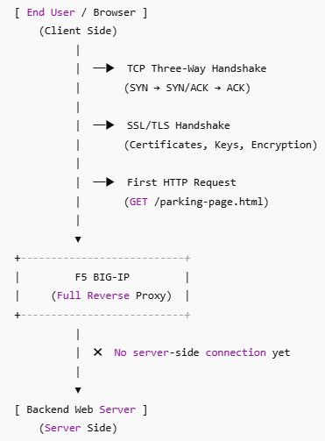
    Reverse Proxy – F5 LTM works as a full reverse proxy – Client Side Flow - LTM
The end user connects to F5 to access https://learning-portal.lab.ae.
  The client machine completes the TCP three-way handshake with the F5 LTM Virtual Server.
  After a successful TCP handshake, the client machine completes the SSL/TLS handshake with the F5 LTM Virtual Server.
  After a successful SSL handshake, the end user sends the first HTTP GET request to the F5 LTM Virtual Server.
  The F5 LTM client-side Virtual Server receives this HTTP request through the client-side interface.
OK, what is an LTM Virtual Server?
  LTM stands for Local Traffic Manager in F5.
  A Virtual Server is a listener in LTM, and it is configured to listen on TCP ports and accept incoming requests.
  In our case, we configured an HTTPS listener (i.e., an HTTPS Virtual Server).
Important points to note:
  So far, the HTTPS Virtual Server receives the HTTP request.
  At this stage, no connection is created to the backend server yet.

Slide 5
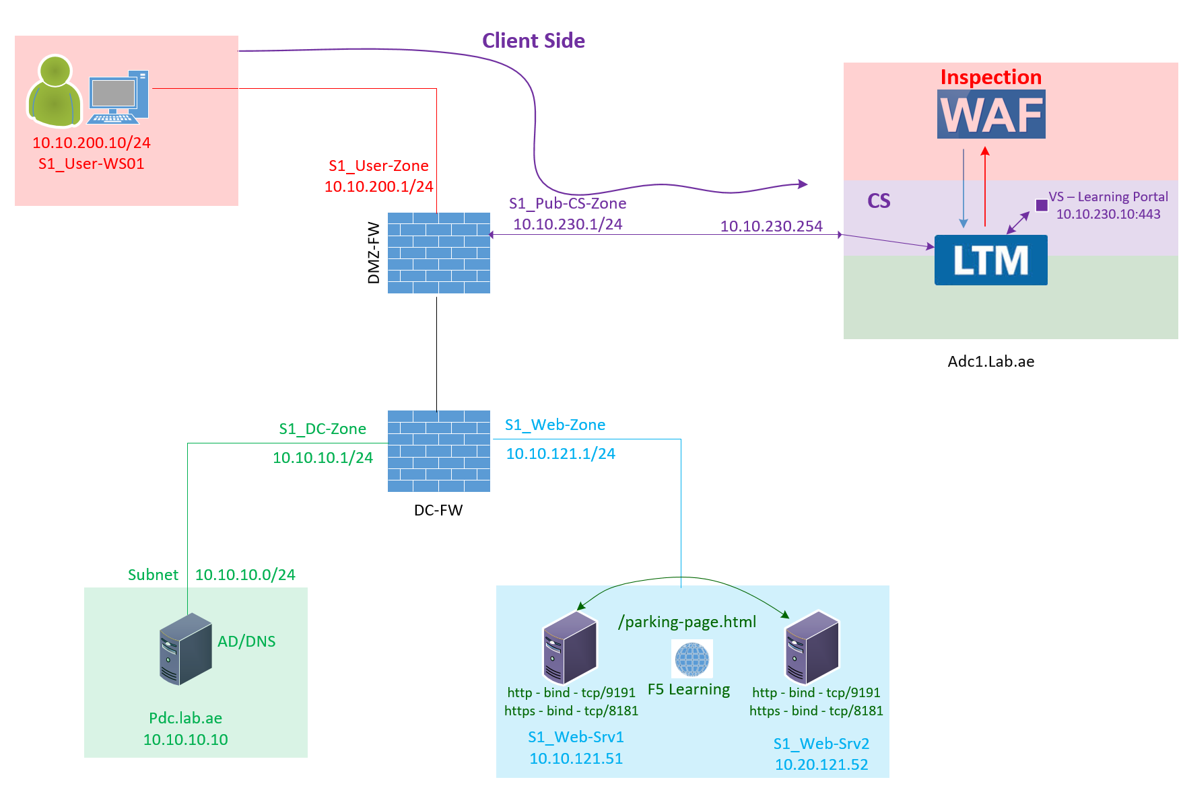
    Reverse Proxy – F5 LTM works as a full reverse proxy – Client Side Flow - LTM
The end user connects to F5 to access https://learning-portal.lab.ae.
  The client machine completes the TCP three-way handshake with the F5 LTM Virtual Server.
  After a successful TCP handshake, the client machine completes the SSL/TLS handshake with the F5 LTM Virtual Server.
  After a successful SSL handshake, the end user sends the first HTTP GET request to the F5 LTM Virtual Server.
  The F5 LTM client-side Virtual Server receives this HTTP request through the client-side interface.
OK, what is an LTM Virtual Server?
  LTM stands for Local Traffic Manager in F5.
  A Virtual Server is a listener in LTM, and it is configured to listen on TCP ports and accept incoming requests.
  In our case, we configured an HTTPS listener (i.e., an HTTPS Virtual Server).
Important points to note:
  So far, the HTTPS Virtual Server receives the HTTP request.
  At this stage, no connection is created to the backend server yet.

Slide 6
    Reverse Proxy – F5 LTM works as a full reverse proxy – Client Side flow - LTM & WAF
When the LTM Virtual Server receives the incoming HTTP request, it checks whether the website needs to be protected.
What does it check?
It checks whether a WAF policy is attached.
WAF stands for Web Application Firewall Module in F5, which protects web applications from bad actors.
If a WAF policy is attached, the request is forwarded to the WAF module for inspection.
The WAF module inspects the request and returns a verdict to LTM:
  If the WAF blocks the request, LTM responds to the client with a WAF block page.
  If the WAF allows the request, the LTM Virtual Server continues processing the traffic further.

Slide 7
    Reverse Proxy – F5 LTM works as a full reverse proxy – Server Side Flow - LTM & WAF
    Server Pool & Health Check
Server Pool & Health Check
The traffic is inspected by WAF and found to be legitimate, so let the F5 proceed creating the server side connection to serve the web request.
Big IP LTM checks the backend server pool
It verifies:
How many pool members are configured.
How many of those pool members are currently available to serve the response.
How is service availability checked?
Service availability is checked using an F5 Health Monitor, which sends health-check requests from the F5 Self IP.
The configured health monitor continuously checks the availability of the service on the web servers at regular intervals.

Slide 8
    Reverse Proxy – F5 LTM works as a full reverse proxy – Server Side Flow - LTM & WAF
    Load Balancing Decision
Load Balancing Decision
After confirming that the healthy pool members are available, the system then evaluates:
The configured load-balancing algorithm
(for example: Round Robin, Least Connections, Ratio, etc.)
Pool member selection
Based on the selected load-balancing algorithm, one eligible (healthy) pool member is chosen to handle the request.

Slide 9
    Reverse Proxy – F5 LTM works as a full reverse proxy – Server Side Flow - LTM & WAF
    Server Side Connection Establishment
Server-Side Connection Establishment
Pool Member Selection: Once a pool member is selected, the BIG-IP creates a new TCP connection to the backend server.
Source IP: This connection is initiated from the server-side Self IP of the BIG-IP.

Slide 10
    Reverse Proxy – F5 LTM works as a full reverse proxy – Server Side Flow - LTM & WAF
    Server-Side Connection Establishment – Which IP Does F5 Use to Create the Backend Connection?
Question:
Will F5 always use the server-side interface (Self IP) to establish the backend connection?
Answer:
It depends on how the system is configured.
If there is a single F5 device and the virtual server is configured with SNAT Auto Map, F5 uses the server-side Self IP to establish the backend connection.
If the F5 is in an HA pair and the virtual server is configured with SNAT Auto Map, F5 uses the Server-Side Floating Self IP to establish the backend connection.
Alternatively, instead of using SNAT Auto Map, you can configure a specific SNAT IP address. In that case, F5 will use the configured SNAT IP to create the backend connection.

Slide 11
    Reverse Proxy – F5 LTM works as a full reverse proxy – Server Side Flow - LTM & WAF
    Server Side Connection Establishment – Server Response
Server-Side Connection Establishment
In our Case - It is single F5 and the virtual server is configured with SNAT Auto Map. So, this connection is initiated from the server-side Self IP of the BIG-IP.
TCP & SSL Handshake: The TCP handshake completes between the BIG-IP and the selected backend server, establishing the server-side SSL connection.
Request Forwarding: Over this server-side SSL connection, the F5 LTM forwards the HTTP request originally sent by the client.
Server Response: The backend server processes the request and returns the response to the F5 Self IP.

Slide 12
    Reverse Proxy – F5 LTM works as a full reverse proxy – LTM Proxy Role
    LTM Proxy Mapping with WAF
Mapping to Client:
  LTM receives the response from the backend server.
  It maps this response to the client-side Virtual Server (VS) IP, ensuring it goes to the correct client connection.
WAF Inspection:
  Since the WAF policy is attached, the LTM forwards the web server response to the WAF before sending it to the client.
  The WAF analyzes the web server response (for sensitive data leaks, content compliance, etc.) and determines if it is safe.
Final Delivery to Client:
The WAF analyzes the response and sends a verdict back to LTM.
  If the WAF verdict is allow, LTM returns the web server response to the client via the Virtual Server IP.
  If the WAF verdict is deny, LTM returns the WAF response to the client via the Virtual Server IP.

Slide 13
    Reverse Proxy – F5 LTM works as a full reverse proxy – LTM Proxy Role
    F5 Full‑Proxy + WAF + Load Balancer Flow Diagram
F5 functions as a full proxy, maintaining separate client‑side and server‑side connections.
The Web Application Firewall (WAF) inspects both inbound client HTTP requests and outbound server responses to enforce security policies.
If the WAF blocks a client request, F5 returns a block page to the user, and no connection is created to any backend server.
The Load Balancer establishes a server‑side connection only after the client request successfully passes WAF inspection.
The Load Balancer performs continuous health checks to monitor the availability and status of all pool members.

Slide 14
This concludes Chapter 04.
I hope this video helped you understand how F5 LTM operates as a Full Proxy.
Continue with Chapter 05 to learn about the concepts of Nodes, Health Monitors, Pools, and Pool Members.
Also, check out Bonus Chapter 03 to see how to set up an F5 VM as a full reverse proxy.
Thank you for watching!
Chapter 04 – F5 LTM operates as a Full Reverse Proxy

